Slide 1

SaaS-Based AI Agent Platform
An Intelligent SaaS Platform for Real-Time AI Agents, Video Communication, and Automated Insights
By
Devesh Patil - (Ai) & Abhishek Maurya - (CC)

Slide 2

INTRODUCTION
Rapid growth of Artificial Intelligence and cloud computing
SaaS enables software access without local installation
AI agents perform tasks autonomously using intelligence
Combination of SaaS + AI agents enables scalable
automation

Slide 3

DESCRIPTION OF THE PROBLEM / TOPIC
Project Analysis – Problem Description
Manual meetings lack intelligent analysis
Important discussion points are often missed
No automated transcript summarization
Existing tools lack integrated AI agents
Need for a smart SaaS-based AI solution

Slide 4

STATUS OF RESEARCH / LITERATURE REVIEW
Project Analysis – Literature Review
AI agents are widely used in automation
Large Language Models enable intelligent interaction
SaaS architecture ensures scalability
Existing tools lack full AI-driven meeting analysis
This project addresses usability and intelligence gaps

Slide 5

DESCRIPTION OF METHODOLOGY
Project Analysis – Methodology
Requirement analysis
System architecture design
Frontend and backend development
AI agent integration
Testing and validation
Cloud deployment

Slide 6

PROPOSED DESIGN / UI DESIGN
Project Analysis – Proposed Design
Secure login and authentication
User dashboard
AI-powered video meeting interface
Live transcript generation
AI-based meeting summaries
Responsive and user-friendly UI

Slide 7
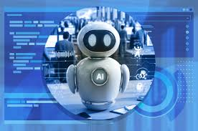
PROBLEM STATEMENT
Traditional AI tools require technical expertise
Lack of centralized platforms for managing AI agents
Existing systems are costly or complex
Need for a user-friendly SaaS AI Agent Platform
It Saves human interaction and Precious time Solving, debating, Queries with users.
Manual meetings lack intelligent insights
Difficult to analyze meetings and transcripts

Slide 8

PROPOSED SOLUTION
SaaS-based AI Agent Platform
AI-powered video calls
Real-time intelligent agents
Automated summaries and transcripts
Secure and scalable cloud deployment

Slide 9

KEY FEATURES / TECHNOLOGIES USED
AI-powered video calls
Custom real-time AI agents
Meeting summaries & transcripts
Transcript search & video playback
AI meeting Q&A
Meeting history & statuses

Slide 10

Next.js 15 & React 19
Tailwind CSS + Shadcn/UI
OpenAI integration
Stream Video & Chat SDK
Better Auth authentication
Polar subscriptions
Inngest background jobs

Slide 11

SYSTEM WORKFLOW
User login via secure authentication
Create or join AI-powered meeting
AI agent listens and analyzes
Transcript and summary generated
User interacts with AI using Q&A

Slide 12
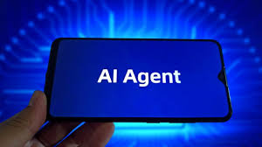
DEPLOYMENT & SECURITY / ADVANTAGES
SaaS cloud deployment
Secure authentication (Better Auth)
Role-based access
Scalable infrastructure
Production-ready environment
Intelligent meeting automation
Saves time and effort
Easy to use SaaS platform
Real-time AI insights
Scalable and future-ready

Slide 13

CONCLUSION
AI agents enhance productivity
SaaS model ensures accessibility
Platform delivers real-world AI value
Strong foundation for future AI expansion

Slide 14
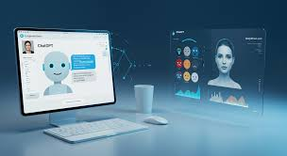
REFERENCES
OpenAI Documentation
LangChain Documentation
SaaS Architecture Research Papers
YouTube: AI Agent SaaS Platform (https://youtu.be/xEDCEmqyvC8?si=Y4izDNTQtNGOFyKv)
YouTube: Deployment & Fixes (https://youtu.be/Kh2FjTFzxJc?si=oVdePeKslSrnDZAX)

Slide 15
Thank You !!
From – Devesh & Abhishek
Seat No: 1321010 / 1331004
University Department of Information Technology
Gmail: patildevesh677@gmail.com/abhi.maurya501@gmail.com

